Slide 1
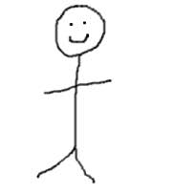
About Me
Austin Courtney

Slide 2
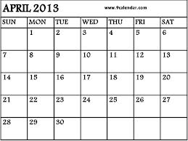
History
Born April 30th, 1999 (14 years old)
Grew up in Martinton, IL
Now live in St. Anne, IL

Slide 3
Education
Donovan Jr. High Graduate
3.2-4.0 GPA throughout my life
Now attending St. Anne Comm. High School (Freshman)

Slide 4
Family
Live with my mom, sister, aunt and uncle
Only one sibling, my 6 yr. old sister Emily
Lots of farm animals and pets
Lots of grandparents, cousins, and aunts and uncles

Slide 5
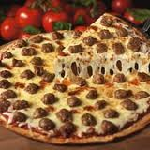
Likes
Sports
Football, Baseball, Basketball, Soccer
Miami Dolphins, Miami Heat, White Sox
Food
Pizza
Spaghetti
McDonald’s
Video Games
Any sport games or Call Of Duty

Slide 6
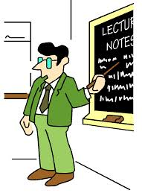
Dislikes
People who explain things multiple times
Doing chores/cleaning
Vegetables (besides corn)
Waking up early
Homework
The Patriots
Cocky people

Slide 7
Short-Term Goals
Pass every class with an A
To not have to take finals
Begin looking for Colleges

Slide 8
Long-Term Goals
Go to Miami to see a Dolphins and Heat game
Visit a foreign country
Graduate College and get a great job
Provide for myself and family if I have one
Meet Will Smith, Kevin Hart, and LeBron James
Never get any kind of ticket

Slide 9
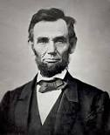
Quotes
“Character is like a tree and reputation is like a shadow. The shadow is what we think of it; the tree is the real thing.” –Abraham Lincoln
“You can tell the greatness of a man by what makes him angry.” –Abraham Lincoln
“Never stop searching, because what you are looking for may be right around the corner.” -Me

Slide 10
To-Do list
Learn how to make myself better as a person
Do more to help others around me
Sleep
Work hard
Be remembered in the future
Be ME

